Slide 1
Measuring Time
Alan L. Cox
alc@cs.rice.edu
Some slides adapted from CMU 15.213 slides

Slide 2
Computer Time Scales
Two Fundamental Time Scales
  Processor: ~10^{–9} s
  External events: ~10^{–2} s
    Keyboard input
    Disk seek
    Screen refresh
Implication
  Can execute many instructions while waiting for external event to occur
  Can alternate among processes without anyone noticing
Microscopic
Time Scale (1 GHz Machine)
Macroscopic
Integer Add
Disk Access
FP Multiply
Keystroke
Screen Refresh
FP Divide
Interrupt
Keystroke
Handler
1 ns
1
μ
s
1 ms
1 s
1.E-09
1.E-06
Time (seconds)
1.E-03
1.E+00

Slide 3
Measurement Challenge
How Much Time Does Program X Require?
  CPU time
    How many total seconds are used when executing X?
    Measure used for most applications
    Small dependence on other system activities
  Actual (“Wall Clock”) Time
    How many seconds elapse between the start and the completion of X?
    Depends on system load, I/O times, etc.
Confounding Factors
  How does time get measured?
  Many processes share computing resources
    Transient effects when switching from one process to another
    Suddenly, the effects of alternating among processes become noticeable

Slide 4
“Time” on a Computer System
real (wall clock) time
= user time (time executing instructions in the user process)
= system time (time executing instructions in kernel on behalf of user process)
= some other user’s time (time executing instructions for a different user process)
+
+
= real (wall clock) time
We will use the word “time” to refer to user time
cumulative user time

Slide 5
Activity Periods: Light Load
  Most of the time spent executing one process
  Periodic interrupts every 10ms
    Interval timer
    Keep system from executing one process to exclusion of others
  Other interrupts
    Due to I/O activity
  Inactivity periods
    System time spent processing interrupts
Activity Periods, Load = 1
Active
1
Inactive
0
10
20
30
40
50
60
70
80
Time (ms)

Slide 6
Activity Periods: Heavy Load
Activity Periods, Load = 2
Active
1
Inactive
0
10
20
30
40
50
60
70
80
Time (ms)
  Sharing processor with one other active process
  From perspective of this process, system appears to be “inactive” for ~50% of the time
    Other process is executing

Slide 7
Interval Counting
OS Measures Runtimes Using Interval Timer
  Maintain 2 counts per process
    User time
    System time
  Each timer interrupt, increment counter for executing process
    User time if running in user mode
    System time if running in kernel mode

Slide 8
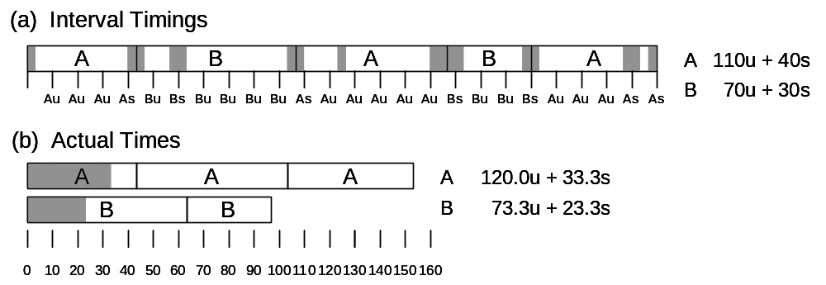
Interval Counting Example

Slide 9
Unix time Command
unix% time make osevent
gcc -O2 -Wall –Wextra -g -c clock.c
gcc -O2 -Wall –Wextra -g -c options.c
gcc -O2 -Wall –Wextra -g -c load.c
gcc -O2 -Wall –Wextra -g -o osevent . . .
0.820u 0.300s 0:01.32 84.8%
  0.82 seconds user time
    82 timer intervals
  0.30 seconds system time
    30 timer intervals
  1.32 seconds wall clock time
  84.8% of total was used running these processes
    (.82+0.3)/1.32 = .848

Slide 10
Accuracy of Interval Counting
Worst Case Analysis
  Timer Interval = δ
  Single process segment measurement can be off by ±δ
  No bound on error for multiple segments
    Could consistently underestimate, or consistently overestimate
A
Computed time = 70ms
Min Actual = 60 + ε
Max Actual = 80 – ε
A
Minimum
Minimum
Maximum
A
Maximum
A
0
0
10
10
20
20
30
30
40
40
50
50
60
60
70
70
80
80

Slide 11
Accuracy of Interval Counting
Average Case Analysis
  Over/underestimates tend to balance out
  As long as total run time is sufficiently large
    Min run time ~1 second
    100 timer intervals
  Consistently miss ~4% overhead due to timer interrupts
A
Computed time = 70ms
Min Actual = 60 + ε
Max Actual = 80 – ε
A
Minimum
Minimum
Maximum
A
Maximum
A
0
0
10
10
20
20
30
30
40
40
50
50
60
60
70
70
80
80

Slide 12
Cycle Counters
Most modern systems have built in registers that are incremented every clock cycle
  Very fine grained
  Often counts elapsed global time
On x86 and x86-64 machines:
  64 bit counter
    Cycle counter period:
      A 3 GHz machine wraps around every 195 years
  Special instruction to access

Slide 13
x86 Cycle Counter
RDTSC
  Assembly instruction to access 64-bit cycle counter
  Places low/high 32 bits in two different registers
  Expressed as machine cycles, not nanoseconds
uint64_t
rdtsc(void)
{
uint32_t low, high;
/* Get cycle counter */
asm("rdtsc“ : "=a" (low), "=d" (high)); /* %eax, %edx */
return (low | ((uint64_t)high << 32));
}

Slide 14
Measuring Cycles with rdtsc()
Idea
  Get current cycle counter
  Compute something
  Get new cycle counter
  Perform 64-bit subtraction to get elapsed cycles
uint64_t start, end;
int i;
int iters = 100;
start = rdtsc();
for (i = 0; i < iters; i++)
getpid();
end = rdtsc();
printf(“getpid(): Average cycles = %ld\n”, (end – start) / iters);

Slide 15
Converting Cycles to Seconds
Idea
  Compute elapsed cycles
  Get processor’s clock frequency (cycles/second)
  Divide elapsed cycles by the clock frequency
How do you get the clock frequency?
UNIX% cat /proc/cpuinfo
processor : 0
vendor_id : GenuineIntel
cpu family : 6
model : 23
model name : Intel(R) Xeon(R) CPU X5460 @ 3.16GHz
stepping : 6
cpu MHz : 3158.758
cache size : 6144 KB
…

Slide 16
Measurement Pitfalls
Overhead/resolution
  Calling rdtsc() incurs some overhead
  Resolution of rdtsc() may not allow very short code sequences to be timed
  Want to measure long enough code sequence to compensate
Unexpected Cache Effects
  artificial hits or misses
  e.g., these measurements were taken with the Alpha cycle counter:
  foo1(array1, array2, array3); /* 68,829 cycles */
  foo2(array1, array2, array3); /* 23,337 cycles */
  vs.
  foo2(array1, array2, array3); /* 70,513 cycles */
  foo1(array1, array2, array3); /* 23,203 cycles */

Slide 17
Dealing with Overhead & Cache Effects
  Always execute function once to “warm up” cache
  Keep doubling number of times execute P() until reach some threshold (i.e., CMIN = 50000)
int cnt = 1;
int i;
uint64_t start, end, tm;
do {
P(); /* Warm up cache */
start = rdtsc();
for (i = 0; i < cnt; i++)
P();
end = rdtsc();
tm = (end – start) / cnt;
cnt += cnt;
} while ((end – start) < CMIN); /* Make sure long enough */
return (tm);

Slide 18
Multitasking Effects
Cycle Counter Measures Elapsed Time
  Keeps accumulating during periods of inactivity
    System activity
    Running other processes
Key Observation
  Cycle counter never underestimates program run time
  Possibly overestimates by large amount

Slide 19
High Resolution CPU Time
#include <time.h>
struct timespec {
time_t tv_sec; /* seconds */
long tv_nsec; /* nanoseconds */
};
int clock_gettime(clockid_t id, struct timespec *tp);
struct timespec ts;
clock_gettime(CLOCK_PROCESS_CPUTIME_ID, &ts);
  High resolution per-process timer based on the cycle counter
    However, higher overhead than rdtsc()
  CLOCK_PROCESS_CPUTIME_ID is not portable (Linux only)

Slide 20
Time of Day Clock
  Unix gettimeofday() function
    Elapsed time since reference time (1/1/1970)
  Implementation
    Uses interval counting on some machines
      Coarse grained
    Uses cycle counter on others
      Fine grained, but significant overhead and only 1 microsecond resolution
#include <sys/time.h>
#include <unistd.h>
struct timeval tstart, tfinish;
double tsecs;
gettimeofday(&tstart, NULL);
P();
gettimeofday(&tfinish, NULL);
tsecs = (tfinish.tv_sec - tstart.tv_sec) +
1e-6 * (tfinish.tv_usec - tstart.tv_usec);

Slide 21
Measurement Summary
Timing is highly case and system dependent
  What is overall duration being measured?
    > 1 second: interval counting is OK
    << 1 second: must use cycle counters
  On what hardware / OS / OS version?
    Accessing counters (clock_gettime? rdtsc?)
    Timer interrupt overhead
    Scheduling policy
Devising a Measurement Method
  Long durations: use Unix time command
  Short durations
    Use clock_gettime or gettimeofday
    Work directly with cycle counters

Slide 22
Important Tools When Optimizing
Observation
  Generating assembly code
    Lets you see what optimizations compiler can make
    Understand capabilities/limitations of particular compiler
Measurement
  Accurately compute time taken by code
    Most modern machines have built in cycle counters
    Using them to get reliable measurements is tricky
  Profile procedure calling frequencies
    Unix: gprof

Slide 23
Profiling Example
Task
  Count word frequencies in text document
  Produce sorted list of words in descending frequency
Steps
  Convert strings to lowercase
  Apply hash function
  Read words and insert into hash table
    Mostly list operations
    Maintain counter for each unique word
  Sort results
Data Set
  Collected works of Shakespeare
  946,596 total words, 26,596 unique
  Initial implementation: 9.2 seconds
Shakespeare’s most frequent words
29,801 | the
27,529 | and
21,029 | I
20,957 | to
18,514 | of
15,370 | a
14,010 | you
12,936 | my
11,722 | in
11,519 | that

Slide 24
Profiling Example
Augment Executable Program with Timing Functions
Computes (approximate) amount of time spent in each function
  Periodically (~ every 10ms) interrupt program
  Determine what function is currently executing
  Increment its timer by interval (e.g., 10ms)
Counts how many times each function is called
gcc –O2 –pg prog.c –o prog
prog
gprof prog
Executes normally, plus generates file gmon.out
Generates profile info from gmon.out

Slide 25
Profiling Example: Results
% cumulative self self total
time seconds seconds calls ms/call ms/call name
86.60 8.21 8.21 1 8210.00 8210.00 sort_words
5.80 8.76 0.55 946596 0.00 0.00 lower1
4.75 9.21 0.45 946596 0.00 0.00 find_ele_rec
1.27 9.33 0.12 946596 0.00 0.00 h_add
average time per function call (self = function, total = function + children)
time and #calls per function
Bottleneck:
Inefficient sort: 1 call = 87% of CPU time

Slide 26
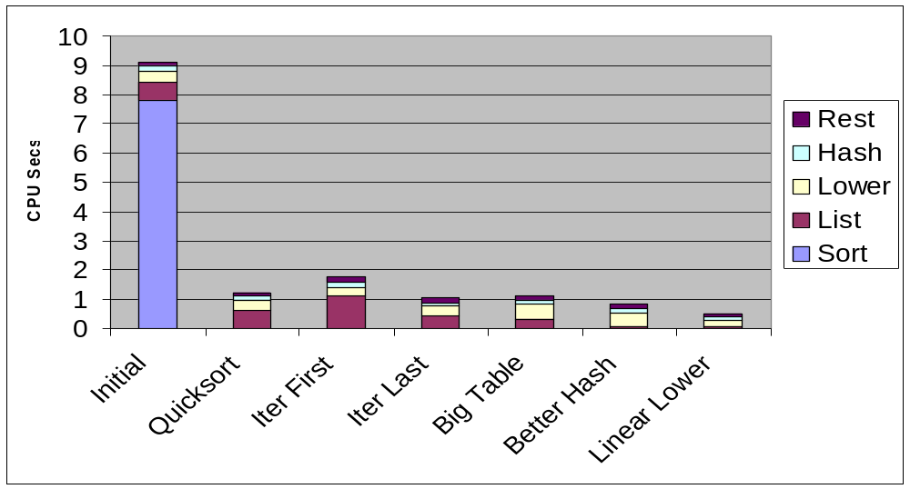
Profiling Example Optimized: 1
Use library qsort instead

Slide 27
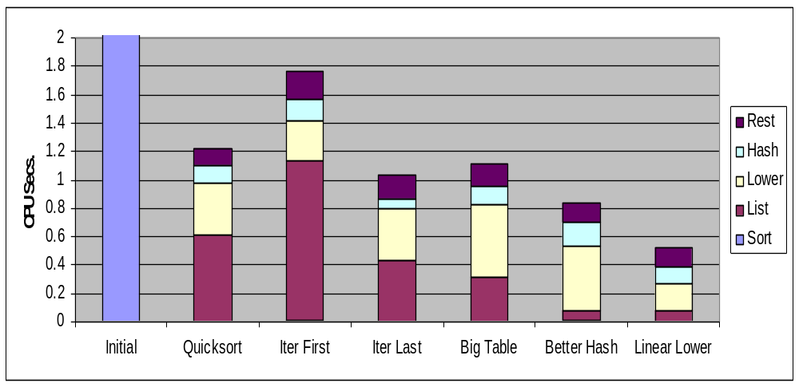
Profiling Example Optimized: 2
Use iterative function to insert elements into linked list first or last
Last → tends to place most common words at front of list
More hash buckets
Better hash function
Move strlen out of lower loop

Slide 28
Profiling Observations
Benefits
  Helps identify performance bottlenecks
  Especially useful with large, complex systems
Limitations
  Only shows performance for data tested
    E.g., mostly short test words → linear lower didn’t gain big
      Quadratic inefficiency could remain lurking in code
  Timing mechanism fairly crude
    Only accurate for programs that run long enough (> 3 sec)
for (i=0; i<strlen(str); i++) {
str[i] = tolower(str[i]);
}

Slide 29
Better profilers
Linux OProfile
  No special compilation options
    Profile preexisting, stock applications
  Uses cycle counters
  Simultaneously profile application and operating system

Slide 30
Next Time
Virtual Memory

